Slide 1

CFD Simulation of a Shell and Tube Heat Exchanger
202359007
LeeMinseong
Energy & Material Circulation System Laboratory

Slide 2
CONTENTS
Introduction
Theory
Results and Discussion
Conclusion
Energy & Material Circulation System Laboratory
Notes:
이번주는 tensorflow에 관한 기본적인 명령에 관해서 공부를 했습니다.

Slide 3
Introduction
Heat Exchangers are essential equipment used in a wide area of applications ranging from HVAC to chemical processes, from power generation facilities to many sectors in industrial manufacturing.
Depending on the required heat rate, cooled or heated media or physical limitations, they may be as simple as a concentric tube type heat exchanger, or as complicated as a plate type heat exchanger with a very high area-to-volume ratio.
Among many types of heat exchangers, The shell and tube type is very common due to their very relatively simple structure, high heat exchange rate and sturdiness.
In this numerical work, CFD simulation of a Shell and Tube Heat Exchanger is performed using the commercial software ANSYS Fluent© .
Energy & Material Circulation System Laboratory

Slide 4








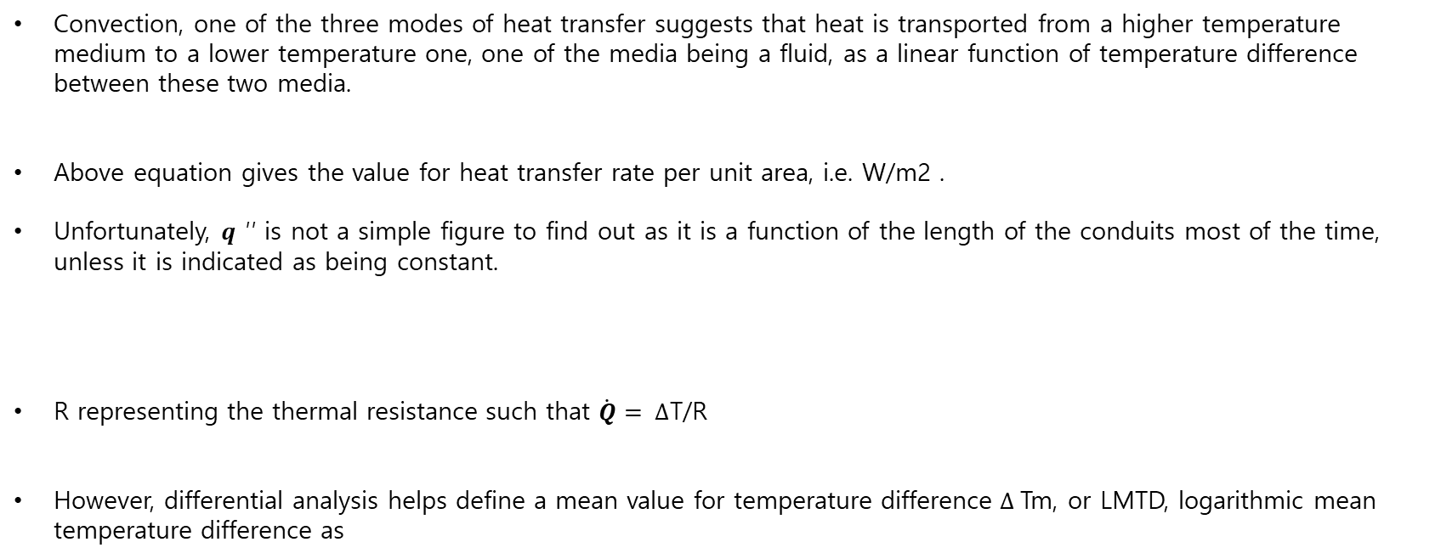
Theory
Convection, one of the three modes of heat transfer suggests that heat is transported from a higher temperature medium to a lower temperature one, one of the media being a fluid, as a linear function of temperature difference between these two media.
Above equation gives the value for heat transfer rate per unit area, i.e. W/m2 .
Unfortunately, 𝒒 ′′ is not a simple figure to find out as it is a function of the length of the conduits most of the time, unless it is indicated as being constant.
R representing the thermal resistance such that $\dot{\text{Q}}= ∆\text{T}\text{/}\text{R}$
However, differential analysis helps define a mean value for temperature difference $∆$Tm, or LMTD, logarithmic mean temperature difference as
: $∆$T1 and $∆$T2 are the temperature differences of flow media at two ends of the heat exchanger.
Energy & Material Circulation System Laboratory

Slide 5




Theory
However, logarithmic mean temperature cannot be calculated unless all the temperatures are known which is most of the time not the case.
There are two types of heat exchanger problems: the one where one is given the requirement for heating/cooling and a design for a brand new heat exchanger is initiated, and the other where one already has a heat exchanger at hand and needs to find out whether it serves a specific heat transfer need.
Using a CFD model will not only help define the geometry better, but also all the characteristics of the heat exchanger to be designed can be visualized beforehand so that the time spent and resources allocated will be minimal.
The current study fits in the second type of heat exchanger analysis which is called the effectiveness method. In this method, a definition for the maximum heat transfer possible is made as:
Additionally, another definition, number of thermal units, NTU=UAs /Cmin is made in order to calculate the effectiveness ϵ of a shell and tube pipe heat exchanger ( one-shell pass; 2,4,… tube passes) such that :
$$: C_{min}=min⁡({\dot{m}}_{c}c_{c},{\dot{m}}_{h}c_{h})$$
$$:c= \frac{{\dot{m}}_{c}cp_{c}}{{\dot{m}}_{h}cp_{h}}$$
Energy & Material Circulation System Laboratory

Slide 6

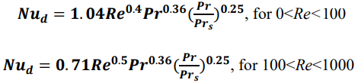

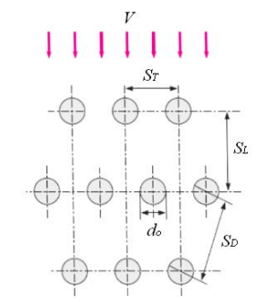


Theory
Flow inside the pipes is laminar for the specified flow rate, however it is not developed hydrodynamically or thermally. Therefore Eq. 7 is used for the entry region:
Nusselt number calculation for the flow domain through the staggered array of tubes is performed using Eq. 8a and 8b:
For tube banks less 16, it is necessary to multiply the Nud above by a correction factor F which is 0.98 for the case in hand. In order to utilize Eq. 8, first of all the velocity need be defined as shown in Eq. 9:
: Re=Vd/$ν$ and Prs is the Prandtl number measured at the surface temperature.
Energy & Material Circulation System Laboratory

Slide 7
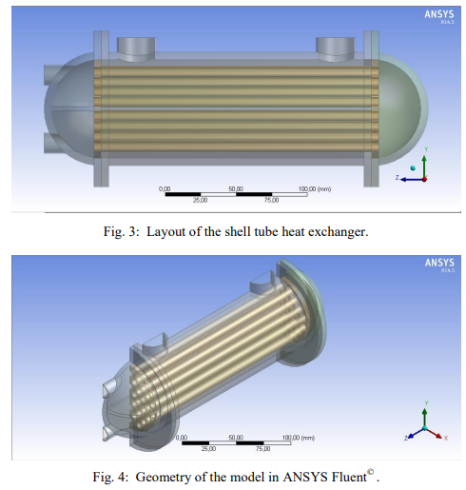
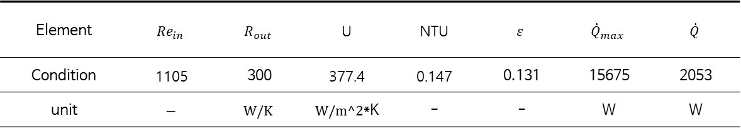
Results and Discussion
The current design consists of a bundle of copper tubes with 8 mm inner diameter with 1 mm wall thickness and a cylindrical outer steel shell with 70 mm inner diameter and 5 mm wall thickness.
The bundle of tubes is 180 mm long and it consists of 36 tubes. The total length of the heat exchanger is 260 mm, including the semi-spherical end caps.
It is intended to cool a flow of oil at a flowrate of 1800 kg/h that enters from the upper right, using water as coolant at a flowrate of 450 kg/h that enters from the lower left.
The inlet temperatures of oil and water are 330oK and 300oK, respectively. Oil has a kinematic viscosity of 20 cSt and density of 890 kg/m3 . Outside surface of shell is assumed to be insulated.
Element | $$Re_{in}$$ | $$R_{out}$$ | U | NTU | $$ε$$ | $${\dot{Q}}_{max}$$ | $$\dot{Q}$$
Condition | 1105 | 300 | 377.4 | 0.147 | 0.131 | 15675 | 2053
unit | $$−$$ | $$W/K$$ | $W/m^2$*K | - | - | W | W
Energy & Material Circulation System Laboratory

Slide 8
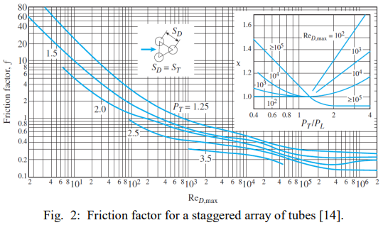

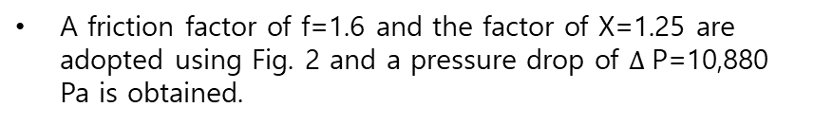
Results and Discussion
A friction factor of f=1.6 and the factor of X=1.25 are adopted using Fig. 2 and a pressure drop of $∆$P=10,880 Pa is obtained.
The first step in using CFD is to construct the geometry (Fig. 4). Owing to the symmetry of the geometry, only half of the domain is studied in order to facilitate the efficient use of computational resources.
The second step is to construct the mesh for the computational domain. Mesh size and type, thus the number of mesh elements decide both the precision of the results and the execution time.
Energy & Material Circulation System Laboratory

Slide 9
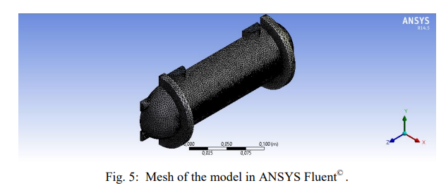
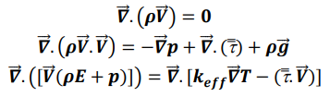

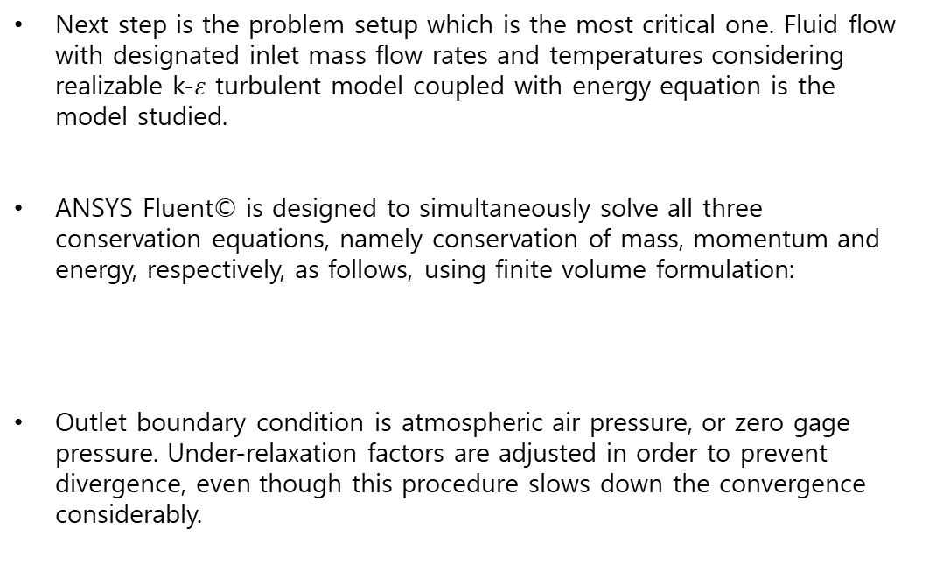
Results and Discussion
2.8 million mesh elements for the half domain.
Next step is the problem setup which is the most critical one. Fluid flow with designated inlet mass flow rates and temperatures considering realizable k-$ε$ turbulent model coupled with energy equation is the model studied.
ANSYS Fluent© is designed to simultaneously solve all three conservation equations, namely conservation of mass, momentum and energy, respectively, as follows, using finite volume formulation:
Outlet boundary condition is atmospheric air pressure, or zero gage pressure. Under-relaxation factors are adjusted in order to prevent divergence, even though this procedure slows down the convergence considerably.
Energy & Material Circulation System Laboratory

Slide 10
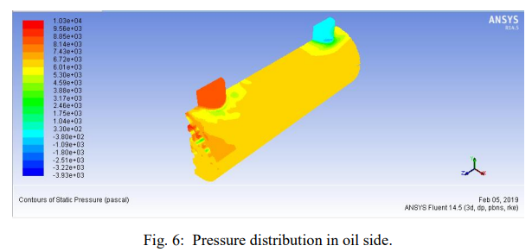
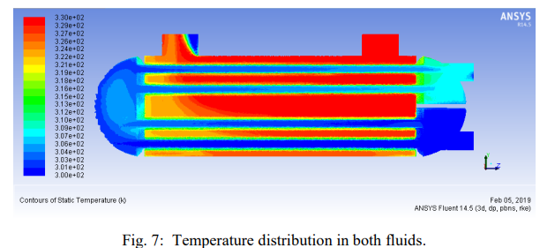
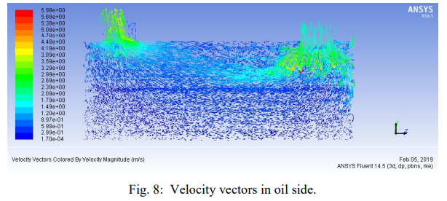
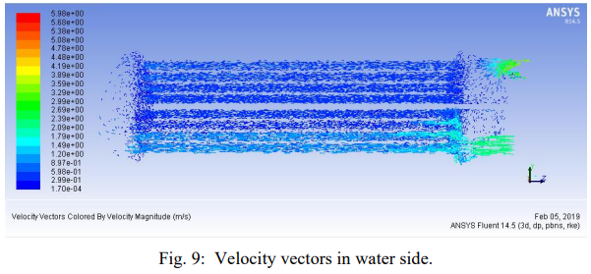
Results and Discussion
The computed heat exchange rate between oil and water being 1961 W, the heat transfer results show that the CFD model has only a difference with analytical results by 4.48%. The computed pressure drop in oil side is $∆$P=10,275 Pa, representing a 5.56% difference.
Energy & Material Circulation System Laboratory

Slide 11
Conclusion
In this numerical work, a numerical model for a Shell and Tube heat exchanger is studied, using the commercial software ANSYS Fluent© .
ANSYS Fluent© produces realistic outputs as far as the heat transfer and the hydrodynamics in fluid flow through the Shell and Tube heat exchangers are concerned.
It is concluded that, following a preliminary design of a Shell and Tube heat exchanger obtained from the analytical formulas and empirical correlations can be validated using a reliable CFD package such as ANSYS Fluent© , making it possible to revise the model as needed before a prototype is manufactured and bench tested.
A followup to this study may be adding baffles into the oil flow domain in different configurations to enhance the heat transfer, however at a penalty of higher pressure loss, thus higher pumping costs.
Energy & Material Circulation System Laboratory

